Slide 1
ENGLISH FOR EVERYONE
Miss Arlene G. Agustin

Slide 2
HOW TO PROPERLY INTRODUCE YOURSELF TO TOURIST

Slide 3
VOCABULARY
OFFICER -
ASSISTANCE –
HELP –
GOOD MORNING-
GOOD AFTERNOON-
GOOD EVENING -

Slide 4
GOODMORNING
GOODAFTERNOON
GOODEVENING
I AM OFFICER __________ HOW MAY I HELP YOU?
I AM OFFICER __________ IS THERE ANYTHING I CAN DO FOR YOU?
MY NAME IS __________ , I AM A POLICE OFFICER DO YOU NEED ANY ASSISTANCE?

Slide 5
TELLING TIME
This topic will help us:
Tell the correct time when asked
Know the difference of 12-hour and 24-hour time

Slide 6
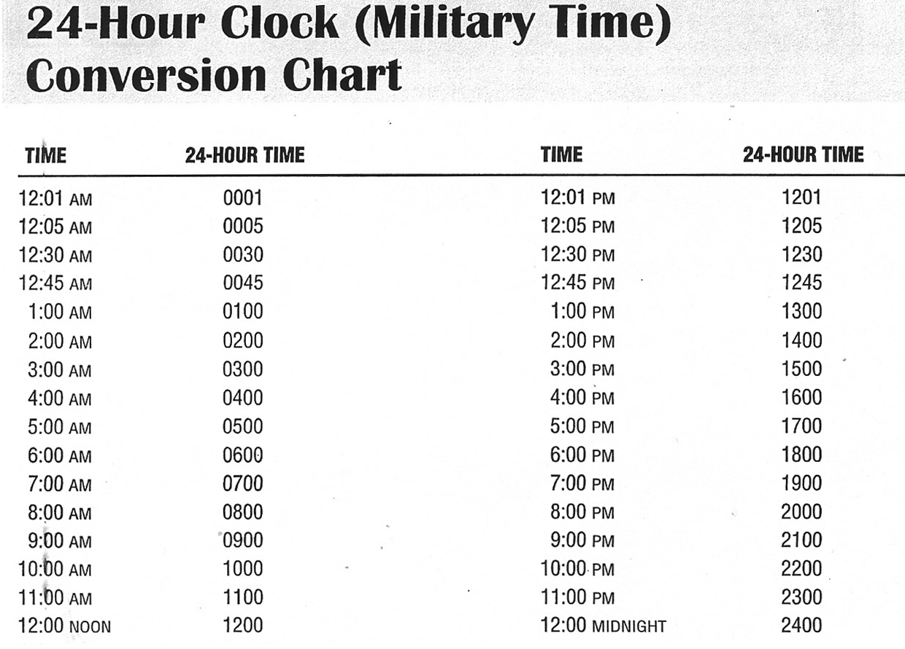
Telling TIME

Slide 7
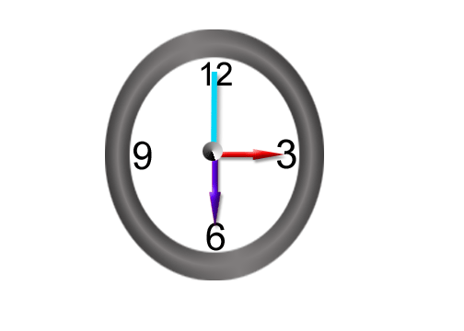
Parts of the Clock
Hour hand
Minute hand
Second hand
Face
To tell the time:
Look at the hour hand first and then the minute hand.

Slide 8
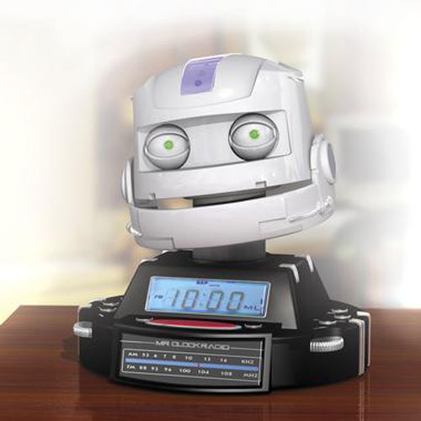
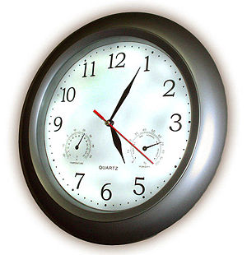
Digital clock Analog clock
A clock with numbers only is called a digital clock.
A clock with hands is called an analog clock.

Slide 9
Different Ways to Say the Time
o'clock
quarter past / quarter after
quarter to
half past

Slide 10
What time does this clock show?
3:00 - Three o'clock

Slide 11
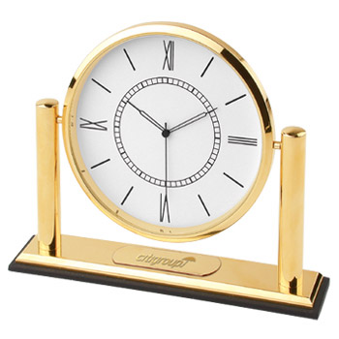
What time does this clock show?
10:10 - Ten – ten / Ten minutes past ten

Slide 12
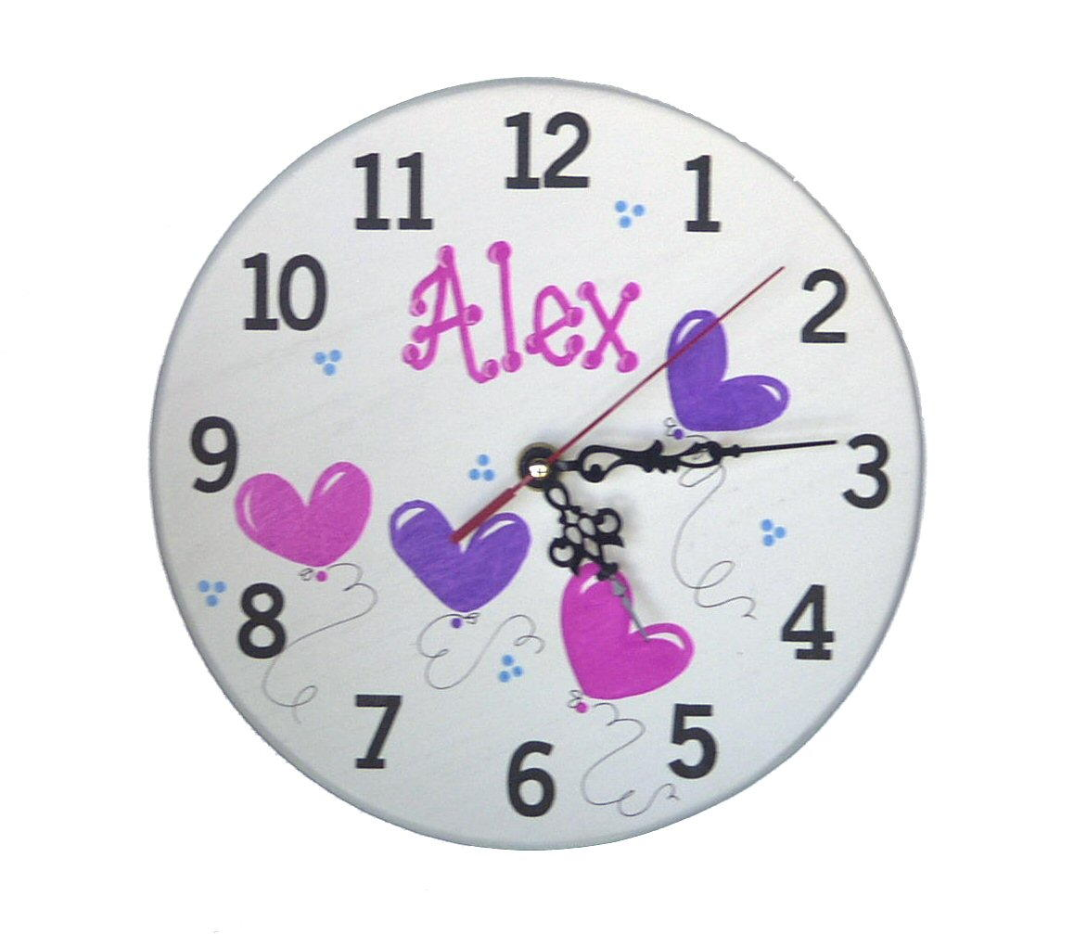
What time is it?
5:15 - Five – fifteen / Quarter past five

Slide 13
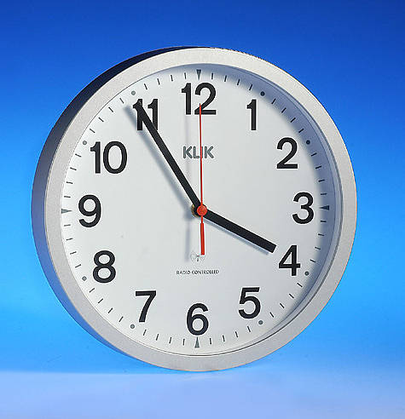
What time is it?
3:55 - three – fifty-five / Five to four

Slide 14
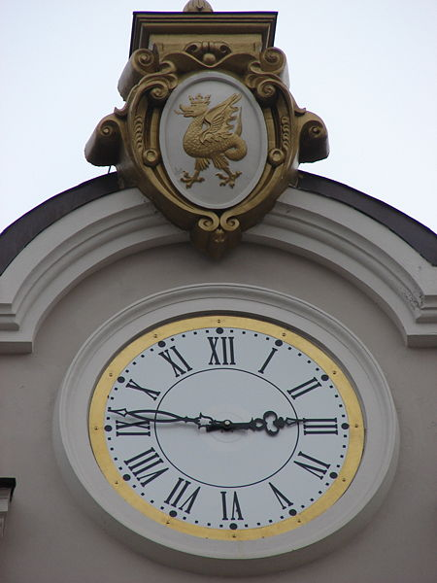
What time is it?
2:45 - two – forty-five /Quarter to three

Slide 15
Telling time
TIME FOR A TEST!!!

Slide 16
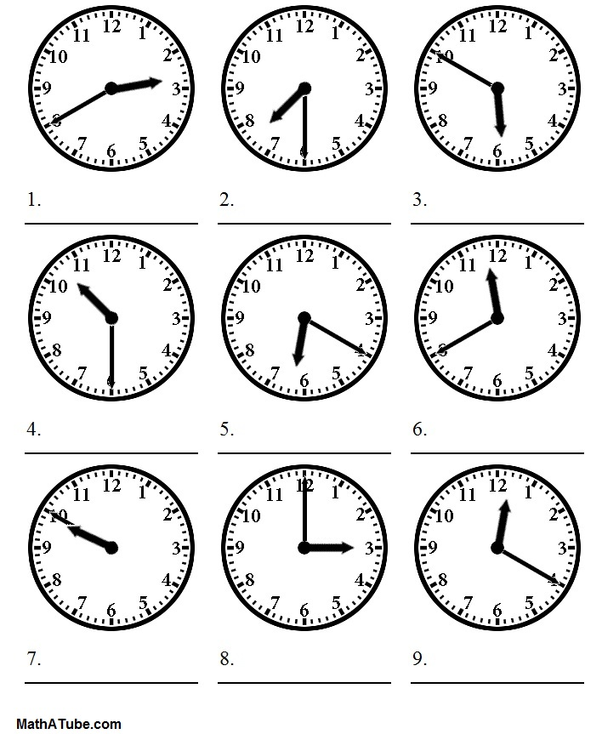

Slide 17
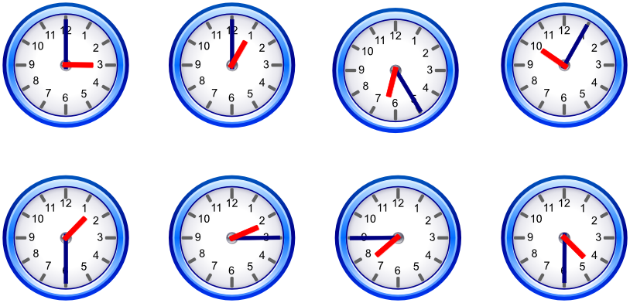
24-hour (MILITARY TIME)
AM
PM
PM
AM
PM
AM
AM
PM

Slide 18
QUESTION AND RESPONSE

Slide 19
WHAT
WHEN
WHERE
WHY
HOW
YES/NO QUESTION

Slide 20
vocabulary
Recommend
Routine
Schedule
Day
Date
Reason
Permission
Inquiry
route

Slide 21
WHAT?
General question.
Example:
What time is the bus coming? (time)
What restaurant can you recommend to us? ( place)
What day can I come back? ( schedule)
What is the best way to go to market village ( route)

Slide 22
WHEN?
Question about time, schedule or routine, day or date
Example:
When will I come back? ( Day or date)
When is the next bus coming?(schedule /routine)
When is it going to open? ( time)

Slide 23
WHERE?
Question about place or location
Example:
Where is the nearest bank? ( place)
Where does this road lead to ( location)

Slide 24
WHY?
Question about reason( because )
Example:
Why can’t we use our camera inside?
Why can’t we come inside the palace?

Slide 25
HOW?
Question for the amount/price, process or steps
Example:
How can I go to market village? ( process )
How much is the entrance fee? ( amount )

Slide 26
YES OR NO
Questions for asking permission / inquiry
Example:
Can I park my car here? ( asking permission)
Is it possible for me to extend my visa here ( inquiry)

Slide 27
Let’s try answering some questions

Slide 28
WHAT
WHAT DO I NEED TO WEAR TO USE THE PALACE GARDEN FOR JOGGING?
WHAT TIME DOES THE PALACE GARDEN OPENS AND CLOSES?

Slide 29
WHEN
WHEN WILL THE BUS COME?
WHEN IS YOUR BIRTHDAY?

Slide 30
WHERE
WHERE CAN I EXCHANGE MY MONEY?
WHERE AM I?

Slide 31
WHY
WHY CAN’T I COME INSIDE THE PALACE?
WHY DO I NEED TO WEAR PANTS TO JOG IN THE PALACE?

Slide 32
HOW
HOW MUCH IS THE FARE FROM HERE TO MARKET VILLAGE?
HOW CAN I GO TO THE BEACH?

Slide 33
YES OR NO
DID YOU HAVE BREAKFAST ALREADY?
CAN I COME INSIDE THE PALACE?

