Slide 1
โครงการฝึกอบรมภาษาอังกฤษ สำหรับพนักงานโรงแรมในอำเภอหัวหิน English for Hotel Staff วันที่ 17-18 พฤษภาคม 2557 ณ ห้อง NB 8

Slide 2
English for Hotel Industry
March 2014
Based on “Be My Guest”
Written by: Francis O’Hara
Cambridge University Press

Slide 3
Course contents
Day 1
Day 2
Introductions
The check-in
Services in the hotel
Location of facilities
Problems & Solutions
Enquiries
Using the phone
Check-out

Slide 4
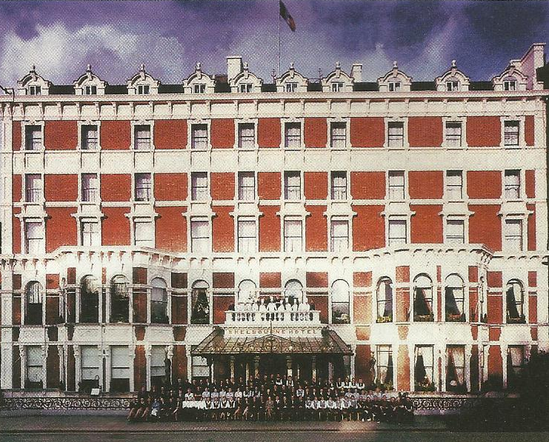

Slide 7
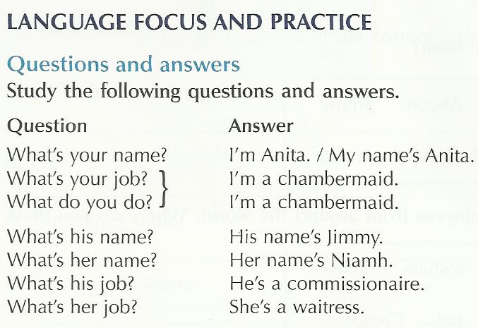
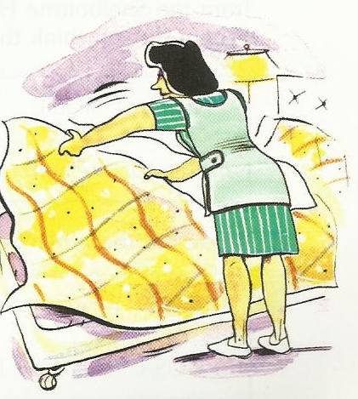

Slide 8
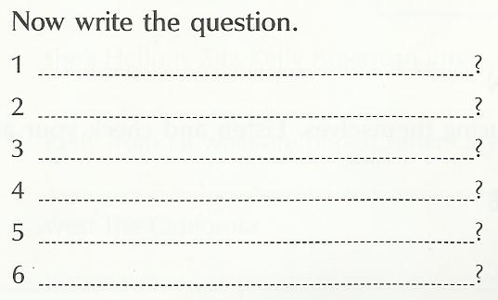
Her name ‘s Kelly.
She ‘s a waitress.
My name’s Taki.
His name’s Shaun.
I’m a waiter.
He’s a commissionaire.
Personal Job File
Write down any new words and phrases.
Complete the questions and answers.

Slide 9
SPEAKING PRACTICE (In groups)
Introduce yourself. Learn the name of each person in your group, and how to spell it.
Study the question:
QUESTION: Could you spell that, please?
ANSWER: Yes, of course, it’s __________.
Find out the job of each person in your group. Notice how we use ‘yes’ and ‘no’
QUESTION: Are you a waiter?
ANSWER: Yes, I am./No, I’m a porter.

Slide 10
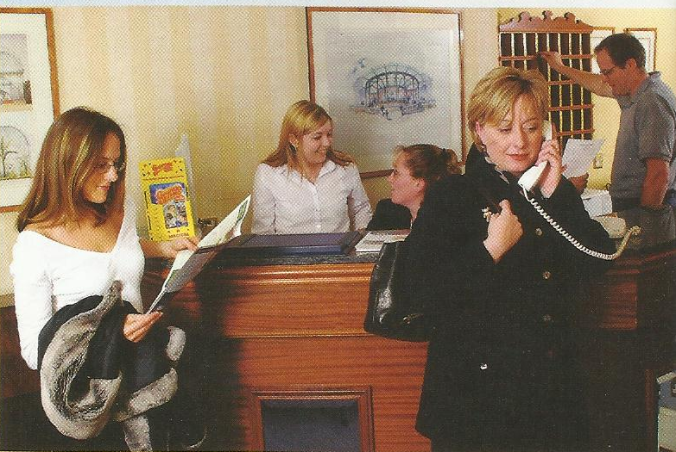
The check-in I have a reservation.
Is this like the reception area of the hotel you work in?
How different is it?

Slide 11
Look at these room types and match each to an abbreviation.
S2 S2D DA S FD D
Single room
Twin room
One bed suite
Double room-one bed
Double room-twin bed
De-luxe double

Slide 12
Listening and pronunciation
Read Mr. Bouvier’s e-mail. Is there a room available for him? Complete the reservation chart.
Dear Sir,
I ‘d like to reserve a double room with bath, from 18-21 July, if possible with a balcony.
Yours sincerely,
Jacques Bouvier

Slide 13
Listening to Mr. Bouvier
He wants to change his reservation.
Is there a suitable room available?
Make changes to the chart.

Slide 14
ROOM NO: ROOM TYPE: | 402 S-BATH | 421 D-SHOWER | 437 D-BATH, BALCONY
DATE JULY 12 | MS. SUNG
13 | MS. SUNG
14
15 |  |  | MR. YAMOTO
16 |  | MS. SADLER | MR. YAMOTO
17 | MR. CORELLI |  | MR. J. GREEN
18
19
20 |  | MR. KLEE
21 | MR. JONES | MR. KLEE
22 | MR. JONES | MR. KLEE
23

Slide 15
Look at these days and dates, then listening and repeat them.
Monday Tuesday Wednesday Thursday Friday Saturday Sunday
1st January 2nd February 3rd March 4th April
5th May 6th June 7th July 8th August
9th September 10th October 11th November 12th December.
First, twenty first, thirty first, second, twenty second, third, twenty third, forth, twenty forth

Slide 16
Ask your partner
What’s today date?
What’s your day off?
When’ is the next national holiday?
When do you go on holiday?
When’s your birthday?

Slide 17
Language focus & practice
Reading and writing
Dear Mr. Bouvier,
Further to our earlier telephone conversation, we are pleased to confirm your new booking as follows:
Arrival: 19 July Departure: 22 July
Room Type: Double room with bath and balcony
Room rate: $189
Confirmation: JU19FD1 408
We look forward to welcoming you on 19 July.
Yours sincerely

Slide 18
Ms. Sung wants to change her reservation.
Dear Sir,
I have a reservation for two nights, the 12th and 13th July for a single room with bath. I would like to change the dates, if possible, to the 15th and 16th July.

Slide 19
Put these phrases into correct order to complete the letter.
….. Dear Ms. Sung,
….. Thank you for your e-mail of…
….. Your new reservation as follows:
….. We are pleased to confirm.
…… to welcoming you on the 15th July.
….. Confirmation: JU15 52B 393
... Arrival: 15th July Departure: 17th July.
... Room rate: $99 per night
... We look forward
… Room type: single room with bath
… Kind Regards,

Slide 20
Personal Job file
Go to your Job file. Write down any new wards and phrases. Write in the dates. Complete the confirmation letter.

Slide 21
Speaking practice
Receptionist: Hello, Globe Hotel, Can I help you?
Mr. Bouvier: Yes, I have a reservation from the 18th to the 21st July for a double room with bath and balcony?
Receptionist: And your name please, sir?
Mr. Bouvier: Bouvier
Receptionist: Could you spell that for me, please?
Mr. Bouvier: Yes, that’s B-O-U-V-I-E-R. I would like to change the dates, if possible, from the 19th to the 22nd of July.

Slide 22
Receptionist: Hold the line a moment and I’ll just check Mr. Bouvier, but I think that’s possible… from the 19th to 22nd did you say?
Mr. Bouvier: Yes, that’s right.
Receptionist: I’m just checking…the 19th to the 22nd….Yes, that’s fine Mr. Bouvier, a double room with bath and balcony for three nights, from the 19th to the 22nd.
Mr. Bouvier: Thank you, so that’s fixed up then?
Receptionist: Yes, it’s done, Mr. Bouvier. We look forward to welcoming you on the 19th.
Mr. Bouvier: Thank you. Goodbye
Receptionist: Have a nice day.

Slide 23
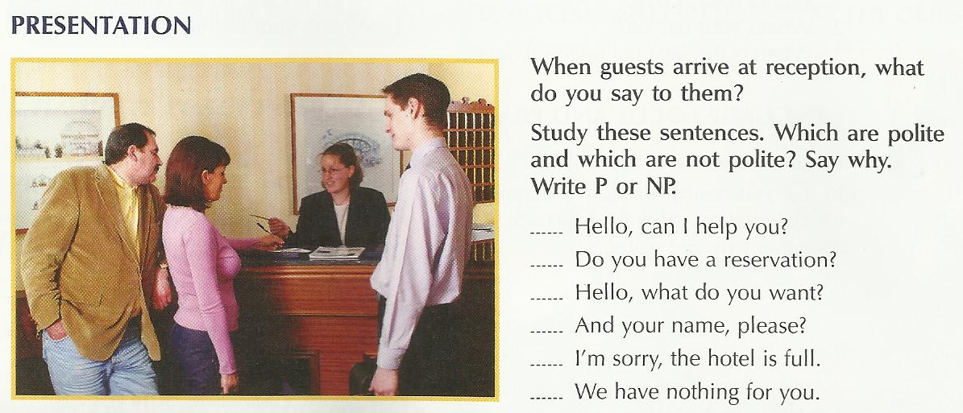

Slide 24
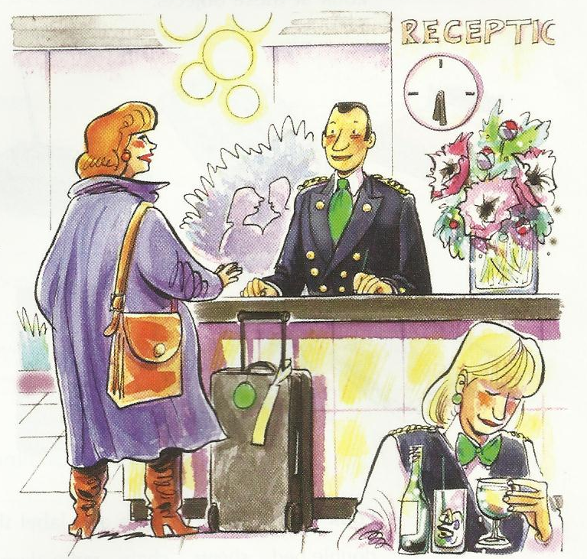
Mr. and Mrs. Bouvier arrive at reception. First mark the sentences G(uest) or R(eceptionist). Then put the sentences in order to make the dialogue between the guest and the receptionist.

Slide 25
R 1 Good evening sir, good evening madam.
… … Thank you. Bouvier, yes… so that’s a double room with bath and balcony for three nights.
… … Thank you, sir, here’s your key. It’s on the forth floor, room 401.
… … Yes, of course.
… … Could you just sign here, please?
… … B-O-U-V-I-E-R
… … Could you spell that, please?
… … Thank you.
… … Good evening, we have a reservation, the name’s Bouvier.
… 6 That’s right.
… … I’ll call a porter.
… … Enjoy your stay.

Slide 26
Listening and pronunciation
Listen to the conversation above and check your answer.
Being clear and polite. Listen to these sentences and repeat them.
Good evening sir, good evening madam. | Could you sign here, please?
Could you spell that, please? | Here’s your key.
That’s a double room with bath and balcony for three nights. | It’s room 401, on the forth floor. I will call a porter.

Slide 27
Language focus and practice
Checking in
This conversation is like the one you heard in 2.7
Complete it using these words.
Seventh floor spell sign here a reservation
Six nights Thank you here’s your single room
Your name call him Good evening right
Would you like Good evening

Slide 28
Receptionist ………………., madam.
Guest ………………. I have ………………….
Receptionist And ………., madam?
Guest Wolfington
Receptionist Could you …………… that, please?
Guest W-O-L-F-I-N-G-T-O-N
Receptionist ………….., Mrs. Wolfington, yes, a ……………. and shower for ………….
Guest That’s……………………
Receptionist Could you just ……….., please?
Guest Yes, of course.
Receptionist Thank you, madam, ……………… key.
It’s room 738 on the ……….
Receptionist …………………….. a porter?
Guest Yes, please.
Receptionist I’ll just ………………Enjoy your stay.
Guest Thank you.

Slide 29
Personal Job File
Write down any new words and phrases.
A guest is checking in. complete the dialogue using your own words.

Slide 30
Focus:
Facilities in the hotel; opening and closing times.
What time does the restaurant open, please?

Slide 31
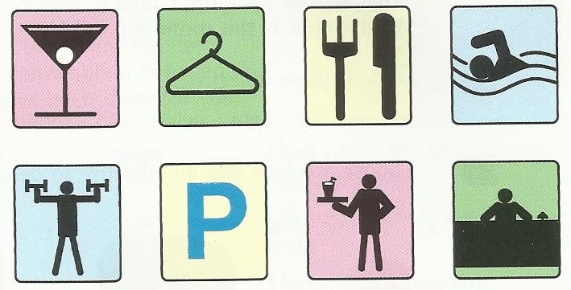
Look at these services and label the pictures.
Bar Restaurant
Fitness center Car park
Reception Swimming pool
Room service Laundry service

Slide 32
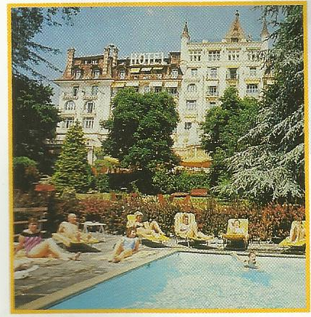
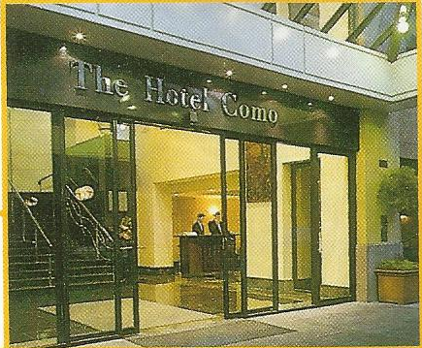
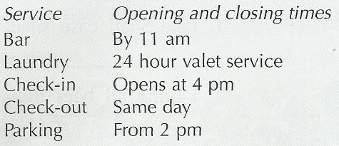

Slide 33
Listening and pronunciation
Listening to the conversations between the employees and guests at the Hotel Royal Savoy and the Hotel Como, about the services in the two hotels. Match the times and services.

Slide 34
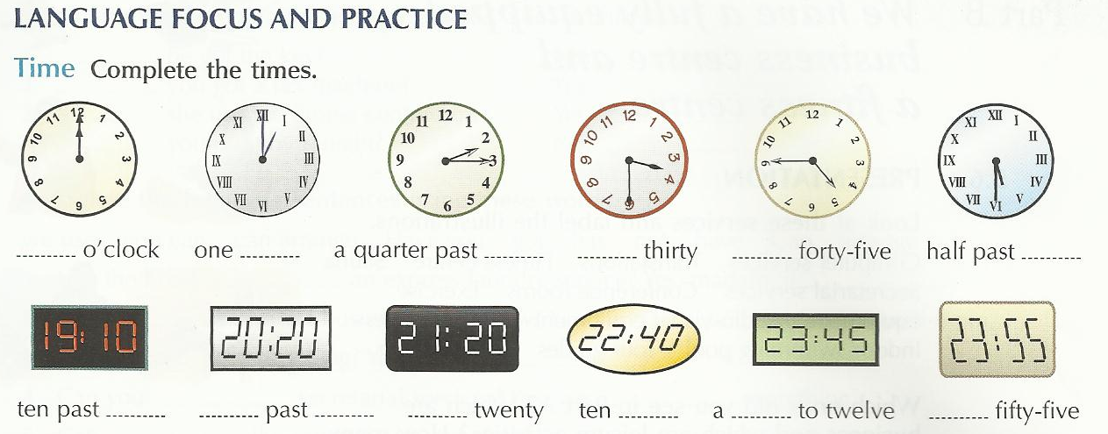

Slide 35
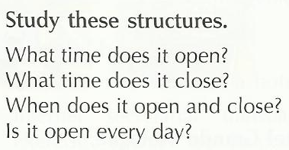
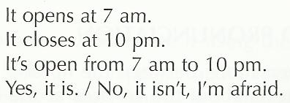
It’s open 7 days a week.
It’s open from Monday t Friday.
It’s open in summer/winter.

Slide 36
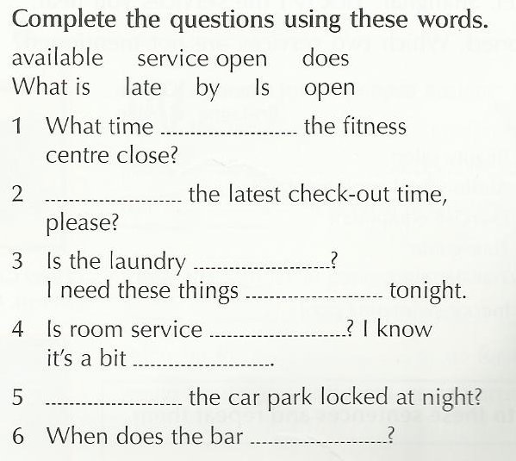

Slide 37
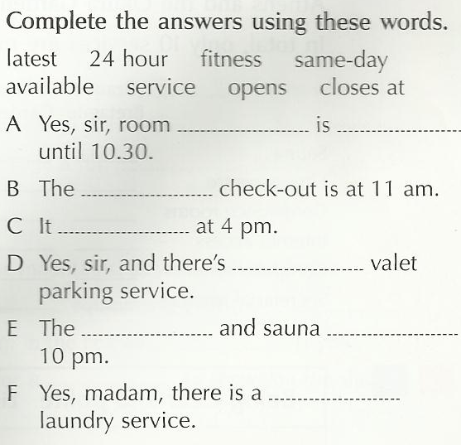

Slide 38
Personal Job File
Write down an new words and phrases. Correct the mistakes in each question and answer given. Write four questions and answers about opening and closing times of services at the hotel where you work.

Slide 39
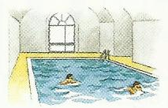
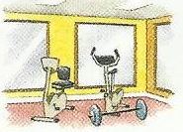
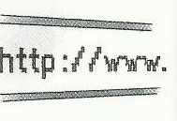

Slide 40
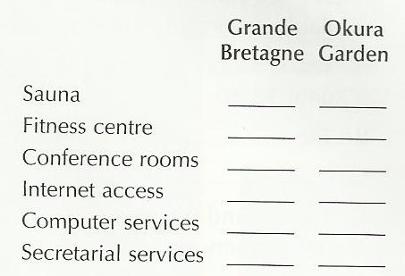
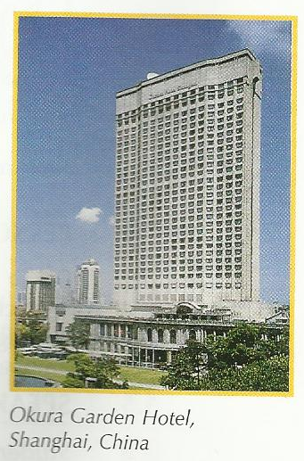
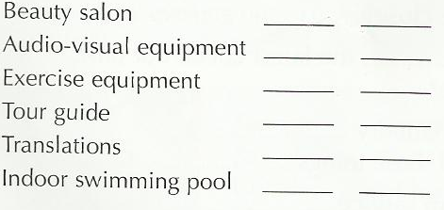

Slide 41
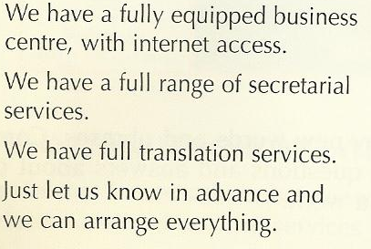
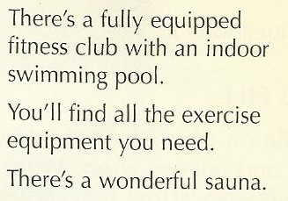

Slide 42
Language focus and practice
Can and I have
Study these questions and answers.
Have you got cable TV in the hotel?
Yes, we have./No, we haven’t.
Has the hotel got an indoor pool?
Yes, it has./ No, it’s hasn’t.
Can we send e-mail from here?
Yes, you can./ No, you can’t.
Can she get a hair appointment at once?
Yes, she can./ No, she can’t.

Slide 44
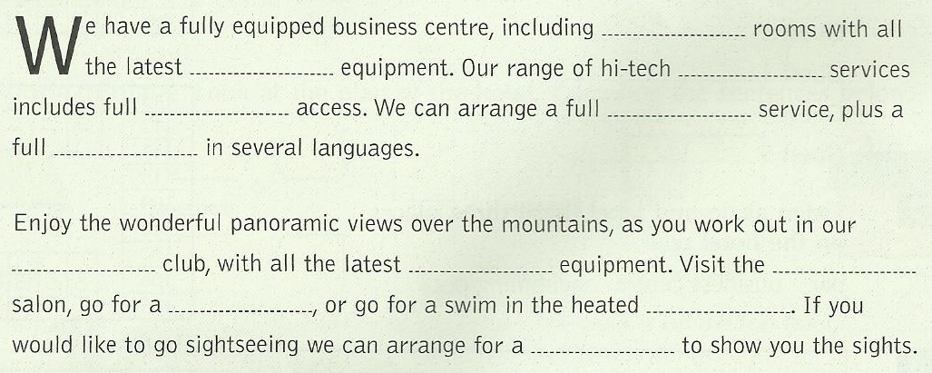

Slide 45
Personal Job File
Go to your Job File.
Write down any new words and phrases.
Write four questions and answers about business and leisure services in the hotel where you work.

Slide 46
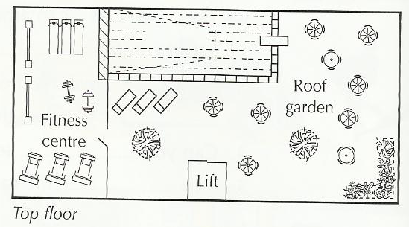

Slide 47
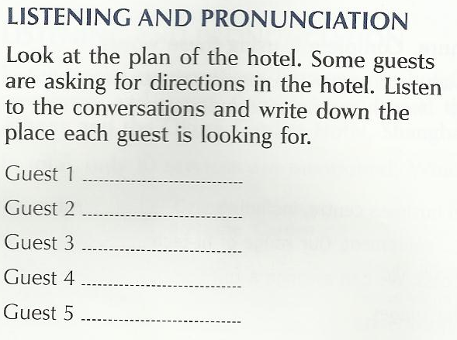
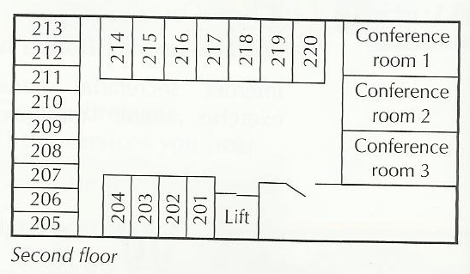

Slide 48
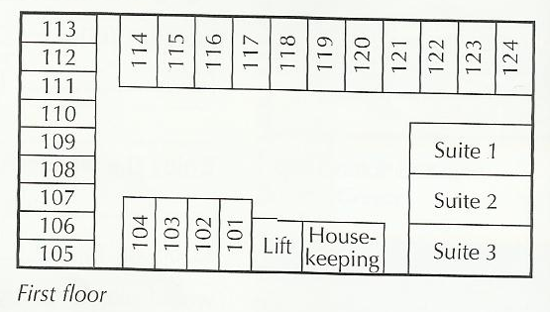

Slide 49
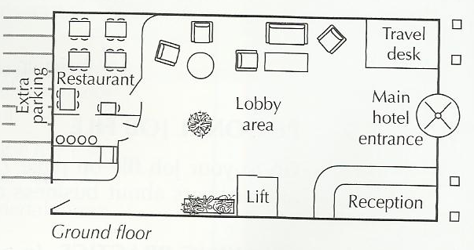

Slide 50
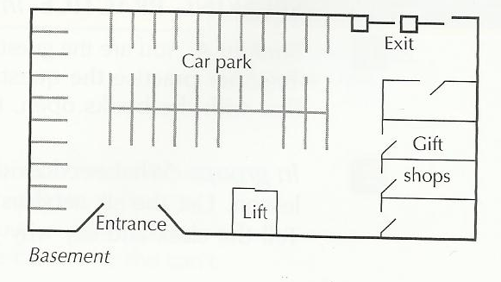

Slide 51
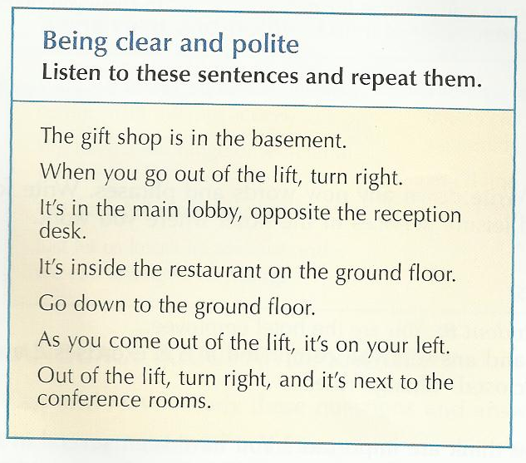

Slide 53
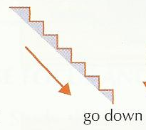
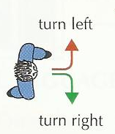
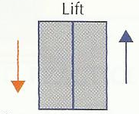
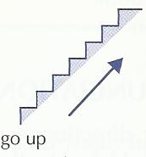
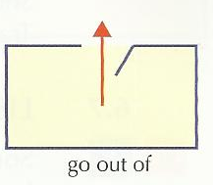
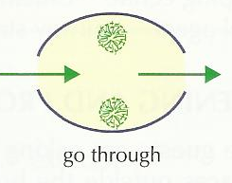

Slide 54
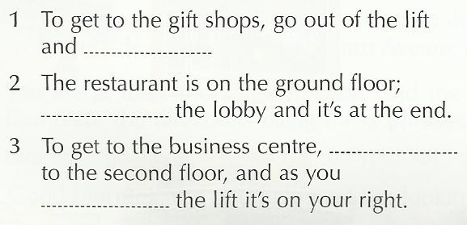
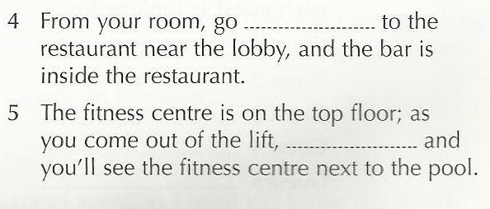

Slide 55
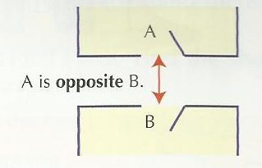
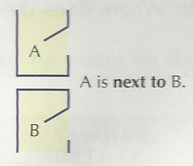
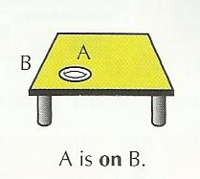
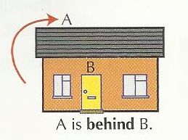
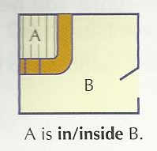

Slide 56
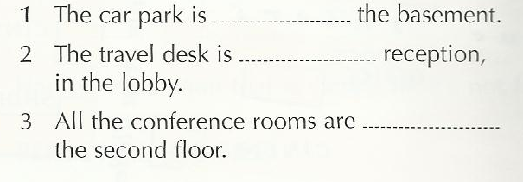
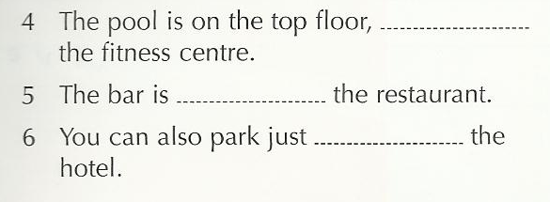

Slide 57
Personal Job File
Go to your job file.
Write down any new words and phrases. You are in the reception area of the hotel where you work. Choose four places guests want to go to inside the hotel. Start from reception. Write down these four directions for guests.

Slide 58
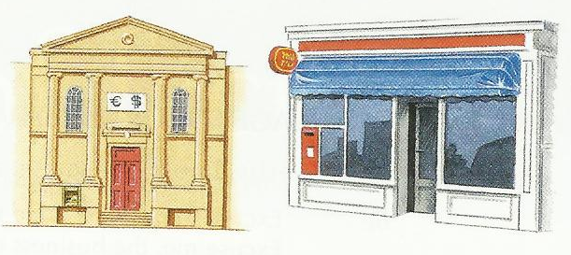
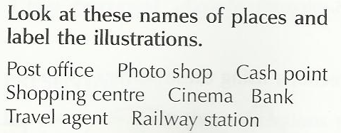
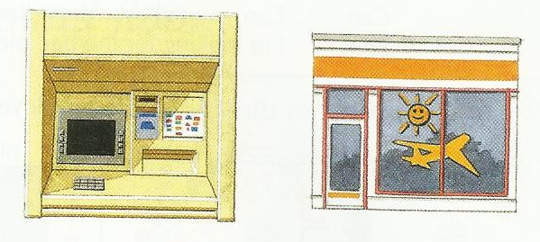

Slide 60
You are at the Hotel Plaza in Nice.
Look at the street plan.
Listen and follow the directions you hear.
Where does the guest want to go to?
The guest wants to go to………

Slide 64
Personal Job File
Go to your personal job file.
Write down any new words and phrases. You are
Go to your job file.
Write down any new words and phrases. You are in the reception area of the hotel where you work. Choose two places outside the hotel that guests ask directions. Start from reception. Write out these directions for guests.

Slide 65
End of Part 1
Hope to see you tomorrow

